Slide 1
🌿 The World of Plants
A Comprehensive Guide to Plant Biology
Topics: Introduction · Plant Parts · Flowers · Monocots & Dicots
Science Department | Grade 6–8 | Botany Unit
Notes:
Welcome students! Today we begin our exciting journey into the world of plants. Ask students: 'Name a plant you saw today.' Plants are everywhere and essential to all life on Earth. This unit covers structure, function, and classification.

Slide 2
What Are Plants?
🌱 Living Organisms
☀️ Photosynthesis
Plants are multicellular living things that grow in soil, water, or other surfaces.
They make their own food using sunlight, water, and CO₂ — a process called photosynthesis.
🌍 Producers
📦 Cell Walls
Plants form the base of most food chains, producing oxygen that all animals breathe.
Unlike animals, plant cells have rigid cell walls made of cellulose for structure and support.
Notes:
Discuss what makes plants unique: autotrophs (make own food), eukaryotic cells with chloroplasts, cell walls, and ability to respond to light (phototropism). Ask: 'How many plant products did you use today?'

Slide 3
Why Are Plants Important?
💨
🍎
💊
🌡️
Oxygen
Food
Medicine
Materials
Climate
Produce ~50% of Earth's oxygen
Source of fruits, vegetables, grains
Basis of many life-saving drugs
Wood, cotton, rubber, paper
Regulate temperature & rainfall
Plants are the foundation of life on Earth!
Notes:
Emphasize the ecosystem services of plants. Ask students to brainstorm additional uses. Mention that rainforests are 'the lungs of Earth' and why deforestation is concerning.

Slide 4
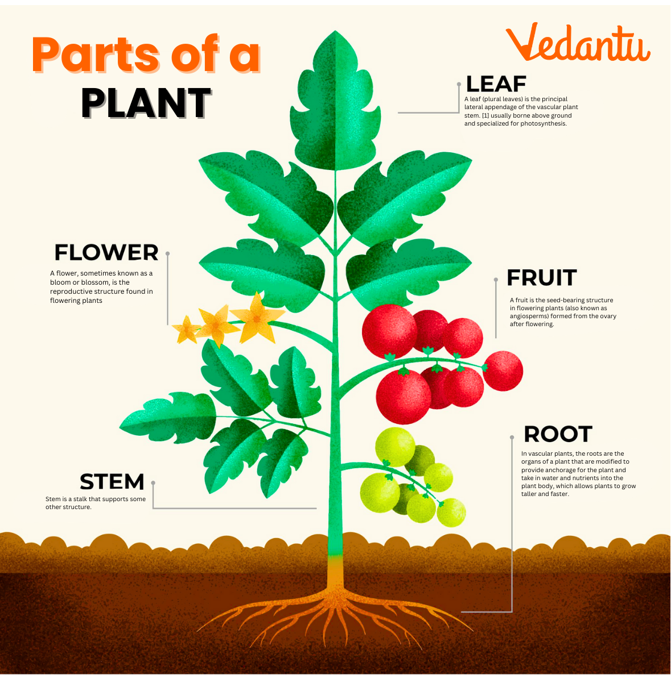
Parts of a Plant
🍃 Leaf
Makes food via
photosynthesis
🌸 Flower
Attracts pollinators,
holds reproductive parts
Fruit
Producces seeds for new plant and provide us food.
🌿 Stem
Supports plant,
transports water
Roots
Absorb water &
minerals from soil
Notes:
Walk students through each part. Use a real plant if available. Ask: 'What do you think would happen to the plant if we removed its leaves?' Discuss how all parts work together for survival.

Slide 5
Functions of Plant Parts
🌸 Flower
🍃 Leaf
Reproduction — attracts pollinators; produces seeds after fertilization.
Photosynthesis — converts sunlight + CO₂ + water into glucose and oxygen.
🌿 Stem
🌱 Root
Support & Transport — holds the plant upright; carries water (xylem) and food (phloem).
Absorption & Anchoring — absorbs water and minerals; anchors plant in soil.
🌰 Seed
🍎 Fruit
Reproduction — contains embryo and food; germinates to form a new plant.
Seed Dispersal — protects seeds and attracts animals to spread them.
Notes:
Have students match each function to a body part analogy: roots = feet/kidneys, stem = spine/blood vessels, leaves = lungs, flowers = reproductive organs. This helps make abstract concepts concrete.

Slide 6
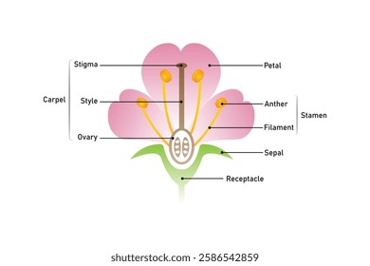
A Closer Look at a Flower
A vibrant flower showcasing its colorful petals and reproductive structures
Notes:
Use this slide to let students observe the flower. Ask: 'What colors do you see? Why might a flower be so colorful?' (Answer: to attract pollinators like bees, butterflies, and hummingbirds.) Discuss the relationship between flowers and their pollinators.

Slide 7
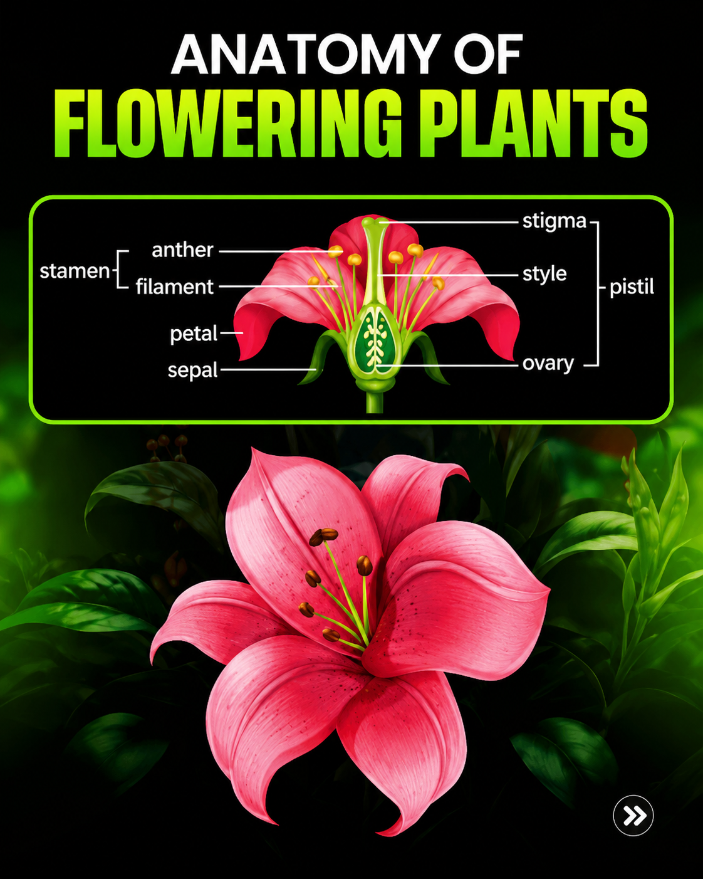
🌸 Anatomy of a Flower
Petal
Brightly colored; attracts pollinators
Notes:
Explain the difference between stamens (male) and pistil (female). A flower with both is called a 'perfect' flower. Discuss pollination — pollen from stamens must reach the stigma of a pistil. Cross-pollination requires an agent (wind, insects, birds).

Slide 8
🌸 Anatomy of a Flower
Petal
Brightly colored; attracts pollinators
Stamen
Male part: anther + filament
Produces pollen
Notes:
Explain the difference between stamens (male) and pistil (female). A flower with both is called a 'perfect' flower. Discuss pollination — pollen from stamens must reach the stigma of a pistil. Cross-pollination requires an agent (wind, insects, birds).

Slide 9
🌸 Anatomy of a Flower
Petal
Brightly colored; attracts pollinators
Stamen
Male part: anther + filament
Produces pollen
Pistil
Female part: stigma + style + ovary
Receives pollen
Notes:
Explain the difference between stamens (male) and pistil (female). A flower with both is called a 'perfect' flower. Discuss pollination — pollen from stamens must reach the stigma of a pistil. Cross-pollination requires an agent (wind, insects, birds).

Slide 10
🌸 Anatomy of a Flower
Petal
Brightly colored; attracts pollinators
Stamen
Male part: anther + filament
Produces pollen
Pistil
Female part: stigma + style + ovary
Receives pollen
Sepal
Protects flower bud
before it opens
Notes:
Explain the difference between stamens (male) and pistil (female). A flower with both is called a 'perfect' flower. Discuss pollination — pollen from stamens must reach the stigma of a pistil. Cross-pollination requires an agent (wind, insects, birds).

Slide 11
🌸 Anatomy of a Flower
Petal
Brightly colored; attracts pollinators
Stamen
Male part: anther + filament
Produces pollen
Pistil
Female part: stigma + style + ovary
Receives pollen
Sepal
Protects flower bud
before it opens
Notes:
Explain the difference between stamens (male) and pistil (female). A flower with both is called a 'perfect' flower. Discuss pollination — pollen from stamens must reach the stigma of a pistil. Cross-pollination requires an agent (wind, insects, birds).

Slide 12
🔬 Key Flower Part Definitions
Petal
Sepal
Modified leaf, often brightly colored, that attracts pollinators (bees, butterflies, birds) to the flower.
Small, leaf-like structures below the petals. They protect the flower bud before it opens. Together called the calyx.
Stamen
Pistil
The male reproductive organ. Made of the filament (stalk) and anther (tip that produces pollen).
The female reproductive organ. Consists of stigma (top), style (tube), and ovary (base containing ovules/eggs).
Receptacle
Nectary
The thickened end of the flower stalk (peduncle) where all flower parts are attached.
Glands that produce sweet nectar to attract pollinators. Usually found at the base of petals.
Notes:
Vocabulary focus slide. Have students write these definitions in their botany journals. Quick quiz idea: show a picture of a flower and ask students to point to each part. Emphasize that stamens = male and pistil = female.

Slide 13
⚖️ Monocot vs Dicot — Comparison
Feature | 🔵 Monocot | 🟠 Dicot
Root | Fibrous root system (many thin roots) | Taproot system (one main large root)
Stem | Vascular bundles scattered throughout stem | Vascular bundles arranged in a ring
Leaf | Parallel leaf veins | Net (reticulate) leaf veins
Flower | Petals in multiples of 3 (3 or 6) | Petals in multiples of 4 or 5
Seed | 1 cotyledon (monocot = mono = one) | 2 cotyledons (dicot = di = two)
Notes:
The names come from 'cotyledon' — the seed leaf inside a seed. MONOcot = 1 seed leaf. DIcot = 2 seed leaves. Memory trick: 'MONOcot has MONO-tone parallel lines on leaves; DICOT has a DIVERS network of veins.' Practice: bring in a grass leaf and a maple leaf for direct comparison.

Slide 14
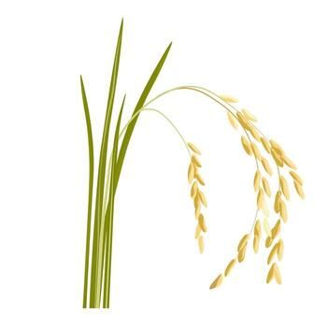
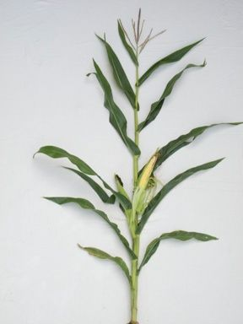
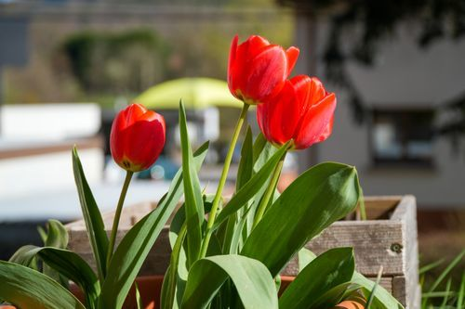
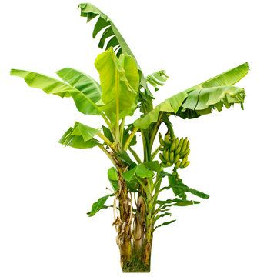
🔵 Examples of Monocot Plants
Staple food for half the world's population. Fibrous roots, parallel leaf veins.
One of the most widely grown crops globally. Flowers in 3s; scattered vascular bundles.
Ornamental flower with petals in multiples of 3 and parallel-veined leaves.
Large tropical monocot with fibrous root system and a pseudostem made of leaf bases.
Key trait: Parallel leaf veins | Fibrous roots | Flower parts in 3s | 1 seed leaf
Notes:
Ask students to find examples of monocots in their daily life at home. Grasses, wheat, barley, sugarcane, onions, and lilies are all monocots. The key identifying feature students should remember is parallel veins on leaves.

Slide 15
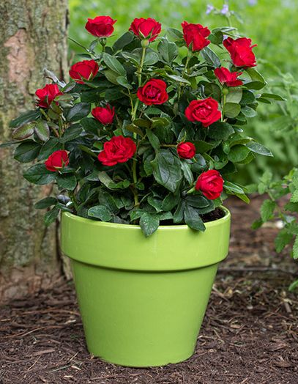
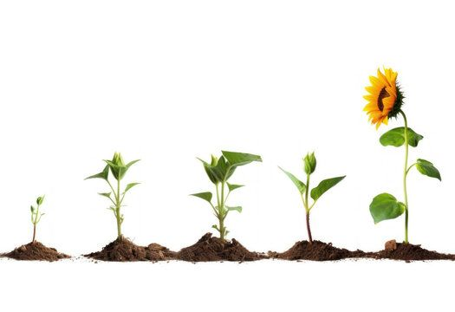
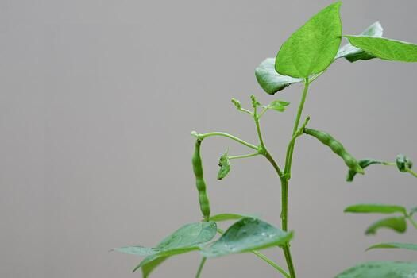
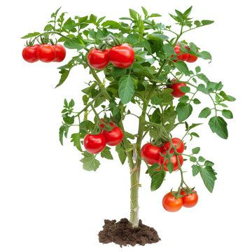
🟠 Examples of Dicot Plants
Classic dicot with net-veined leaves, petals in 5s, and a strong taproot system.
Tall dicot with a large compound flower head. Taproots anchor deeply into soil.
Dicot with reticulate (netted) leaf veins;
5-petalled flowers; edible fruit.
Clear 2-cotyledon seed;
net-veined leaves; taproot anchors plant firmly.
Key trait: Net leaf veins | Taproot | Flower parts in 4s or 5s | 2 seed leaves
Notes:
Most trees and vegetable garden plants are dicots. Examples to add: oak, mango, pea, mustard, carrot. The 2-cotyledon seed is the defining feature. Bring in bean seeds pre-soaked so students can physically split them open and see the 2 cotyledons.

Slide 16
📚 What We've Learned
01
Plants are autotrophs — they make food using photosynthesis.
02
Every plant part (root, stem, leaf, flower, seed) has a specific function.
03
Flowers have male (stamen) and female (pistil) reproductive organs.
04
Monocots: 1 cotyledon, parallel veins, fibrous roots, petals in 3s.
05
Dicots: 2 cotyledons, net veins, taproot, petals in 4s or 5s.
🌿 Plants — The Foundation of All Life on Earth 🌿
Notes:
Wrap-up activity: Give each student an index card. One side: draw and label a monocot leaf. Other side: draw and label a dicot leaf. Exit ticket: 'Name one monocot and one dicot you ate or saw today.' Preview next lesson: Photosynthesis in detail.

